Slide 1
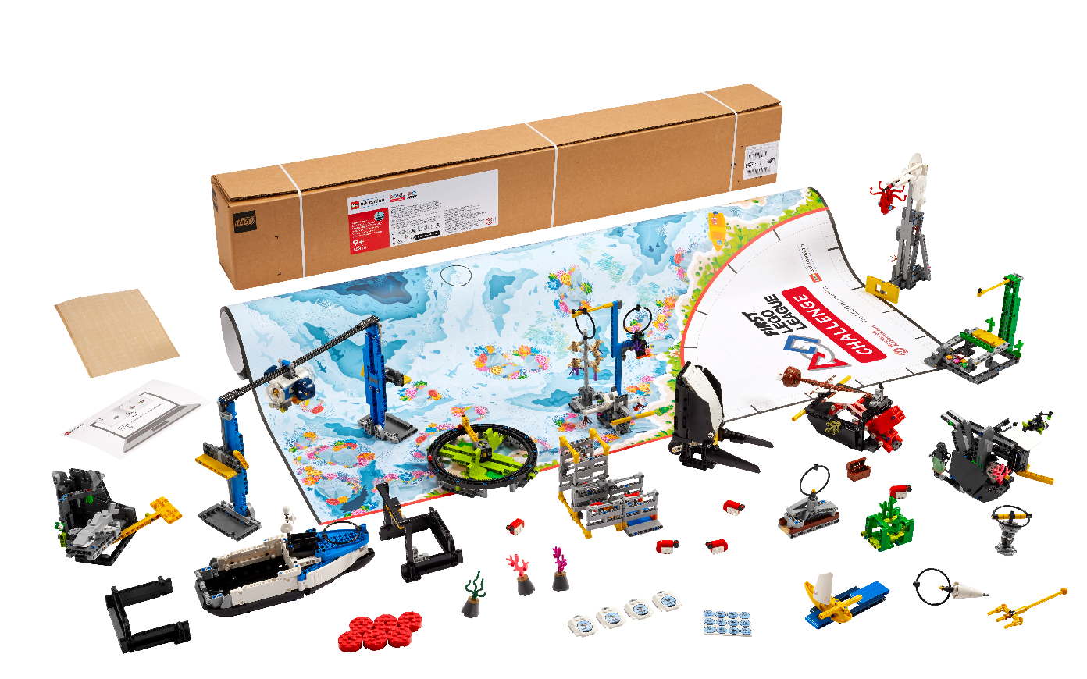


Session 5
Investigate Ideas
Notes:
Facilitator Tips - Team-building activities are great for teams to develop, use their Core Values, and learn how to work together.
Session 5 Tips =
The team should be able to describe what everyone’s strong points are and why they like working with them.
If the team is sharing one robot, they can code on individual devices and then take turns running their programs on the robot.
The provided program for the guided mission will not only solve the Theater Scene Change mission but will also be helpful to use on other missions.
Remind the team to test program changes in small steps instead of changing the entire program at once.
If an attachment is needed for a mission, keep it in a plastic bag labeled with the mission number.

Slide 2
Session Overview
Outcomes
The team will apply coding principles to the guided mission.
The team will research solutions and identify their innovation project problem to solve. (Revisit page 6 of the Engineering Notebook.)
Notes:
Session Outcomes
Apply coding principles to the guided mission.
Identify their innovation project problem to solve and research solutions. (Revisit page 6 of the Engineering Notebook.)
Facilitator Tips - Team-building activities are great for teams to develop, use their Core Values, and learn how to work together.
Session 5 Tips =
The team should be able to describe how everyone contributes to the team.
If the team is sharing one robot, they can code on individual devices and then take turns running their programs on the robot.
The provided program for the guided mission will not only solve the “Send over the Submersible” mission but also be helpful to use on other missions.
Remind the team to test program changes in small steps instead of changing the entire program at once.
If an attachment is needed for a mission, keep it in a plastic bag labeled with the mission number.
Teams should be able to clearly define the problem they have chosen. This is evaluated during the judging session at the event.
The team will write their problem statement here. Remember, teams can choose one of the problems from the Project Sparks if they are unable to come up with their own idea. If they have multiple ideas, they could use a voting process to narrow it down to one.
Project resource examples include websites, videos, books, magazines, personal stories, user experiences, and experts.
The team should record what they learn and note any questions that still need to be researched to develop their solution.

Slide 3
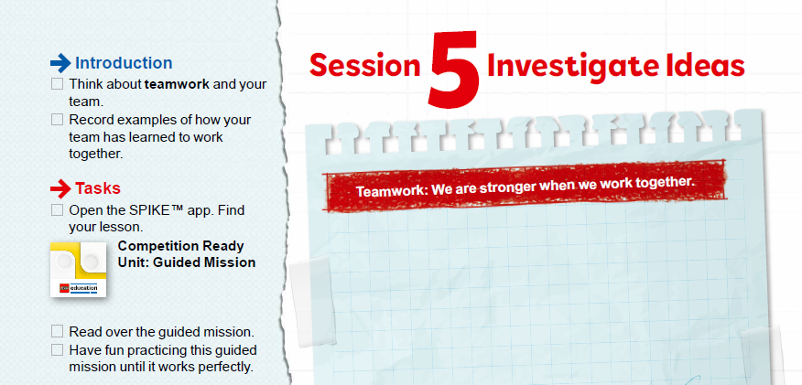

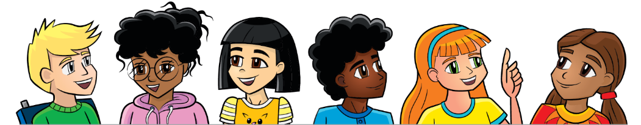
Introduction
Think about teamwork and your team.
Record examples of how your team has learned to work together.
Notes:
Introduction (10-15 minutes)
Session Outcomes
Apply coding principles to the guided mission.
Identify their innovation project problem to solve and research solutions. (Revisit page 6 of the Engineering Notebook.)
Facilitator Tips - Team-building activities are great for teams to develop, use their Core Values, and learn how to work together.
Session 5 Tips =
The team should be able to describe how everyone contributes to the team.
If the team is sharing one robot, they can code on individual devices and then take turns running their programs on the robot.
The provided program for the guided mission will not only solve the “Send over the Submersible” mission but also be helpful to use on other missions.
Remind the team to test program changes in small steps instead of changing the entire program at once.
If an attachment is needed for a mission, keep it in a plastic bag labeled with the mission number.
Teams should be able to clearly define the problem they have chosen. This is evaluated during the judging session at the event.
The team will write their problem statement here. Remember, teams can choose one of the problems from the Project Sparks if they are unable to come up with their own idea. If they have multiple ideas, they could use a voting process to narrow it down to one.
Project resource examples include websites, videos, books, magazines, personal stories, user experiences, and experts.
The team should record what they learn and note any questions that still need to be researched to develop their solution.

Slide 4
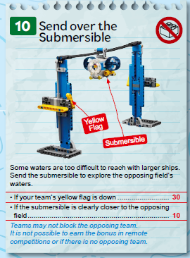

Guided Mission
Open the SPIKE™ Prime app. Find your lesson.
Read over the guided mission.
Have fun practicing this guided mission until it works perfectly!
Notes:
Team Tasks (100-120 minutes) – The Guided Mission – https://education.lego.com/en-us/lessons/prime-competition-ready
URL for SPIKE on-line: https://spike.legoeducation.com (remember to use a Chrome browser)
Session Outcomes
Apply coding principles to the guided mission.
Identify their innovation project problem to solve and research solutions. (Revisit page 6 of the Engineering Notebook.)
Facilitator Tips - Team-building activities are great for teams to develop, use their Core Values, and learn how to work together.
Session 5 Tips =
The team should be able to describe how everyone contributes to the team.
If the team is sharing one robot, they can code on individual devices and then take turns running their programs on the robot.
The provided program for the guided mission will not only solve the “Send over the Submersible” mission but also be helpful to use on other missions.
Remind the team to test program changes in small steps instead of changing the entire program at once.
If an attachment is needed for a mission, keep it in a plastic bag labeled with the mission number.
Teams should be able to clearly define the problem they have chosen. This is evaluated during the judging session at the event.
The team will write their problem statement here. Remember, teams can choose one of the problems from the Project Sparks if they are unable to come up with their own idea. If they have multiple ideas, they could use a voting process to narrow it down to one.
Project resource examples include websites, videos, books, magazines, personal stories, user experiences, and experts.
The team should record what they learn and note any questions that still need to be researched to develop their solution.

Slide 5
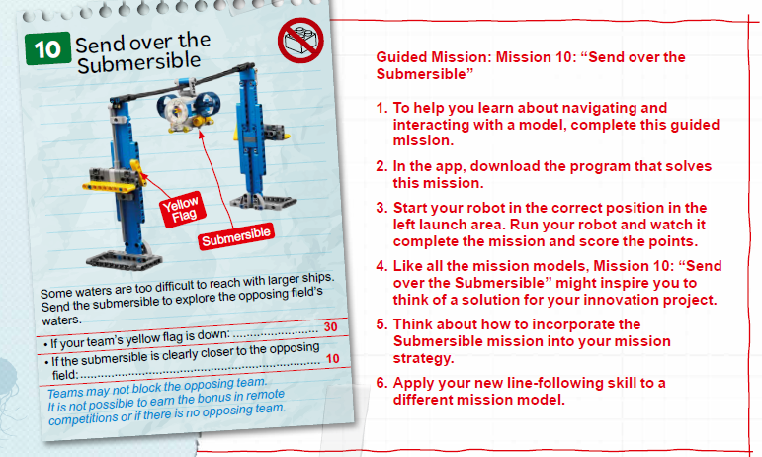
Guided Mission
Notes:
To help you learn about navigating and interacting with a model, complete this guided mission.
In the app, download the program that solves this mission.
Start your robot in the correct position in the left launch area. Run your robot and watch it complete the mission and score the points.
Like all the mission models, Mission 10: “Send over the Submersible” might inspire you to think of a solution for your innovation project.
Think about how to incorporate the Submersible mission into your mission strategy.
Apply your new line-following skill to a different mission model.

Slide 6
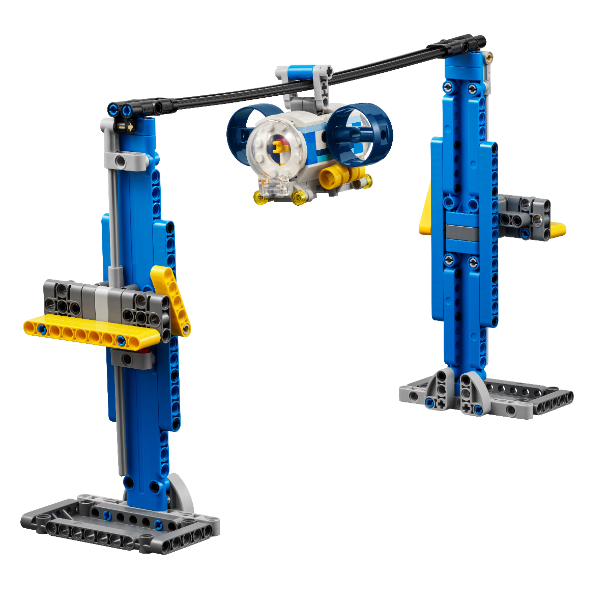
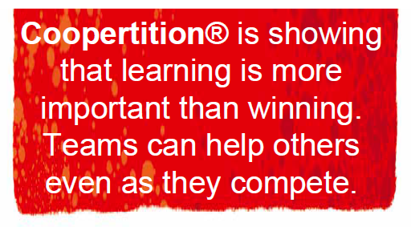
Reflection Questions
What does the guided mission show you about Coopertition®?
Can you change the program so that the mission works when you start the robot from the opposite launch area?
Notes:
Team Tasks (100-120 minutes) – The Guided Mission – https://education.lego.com/en-us/lessons/prime-competition-ready
URL for SPIKE on-line: https://spike.legoeducation.com (remember to use a Chrome browser)
Session Outcomes
Apply coding principles to the guided mission.
Identify their innovation project problem to solve and research solutions. (Revisit page 6 of the Engineering Notebook.)
Facilitator Tips - Team-building activities are great for teams to develop, use their Core Values, and learn how to work together.
Session 5 Tips =
The team should be able to describe how everyone contributes to the team.
If the team is sharing one robot, they can code on individual devices and then take turns running their programs on the robot.
The provided program for the guided mission will not only solve the “Send over the Submersible” mission but also be helpful to use on other missions.
Remind the team to test program changes in small steps instead of changing the entire program at once.
If an attachment is needed for a mission, keep it in a plastic bag labeled with the mission number.
Teams should be able to clearly define the problem they have chosen. This is evaluated during the judging session at the event.
The team will write their problem statement here. Remember, teams can choose one of the problems from the Project Sparks if they are unable to come up with their own idea. If they have multiple ideas, they could use a voting process to narrow it down to one.
Project resource examples include websites, videos, books, magazines, personal stories, user experiences, and experts.
The team should record what they learn and note any questions that still need to be researched to develop their solution.

Slide 7
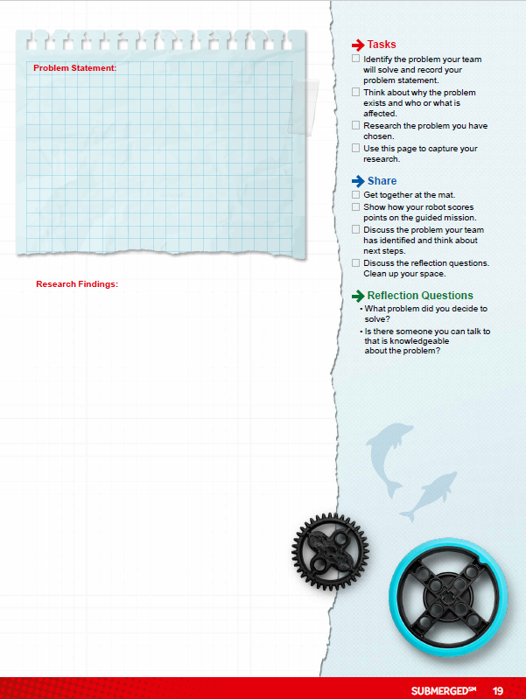


Investigations
Identify the problem your team will solve and record your problem statement.
Think about why the problem exists and who or what is affected.
Notes:
Team Tasks (100-120 minutes)
Session Outcomes
Apply coding principles to the guided mission.
Identify their innovation project problem to solve and research solutions. (Revisit page 6 of the Engineering Notebook.)
Facilitator Tips - Team-building activities are great for teams to develop, use their Core Values, and learn how to work together.
Session 5 Tips =
The team should be able to describe how everyone contributes to the team.
If the team is sharing one robot, they can code on individual devices and then take turns running their programs on the robot.
The provided program for the guided mission will not only solve the “Send over the Submersible” mission but also be helpful to use on other missions.
Remind the team to test program changes in small steps instead of changing the entire program at once.
If an attachment is needed for a mission, keep it in a plastic bag labeled with the mission number.
Teams should be able to clearly define the problem they have chosen. This is evaluated during the judging session at the event.
The team will write their problem statement here. Remember, teams can choose one of the problems from the Project Sparks if they are unable to come up with their own idea. If they have multiple ideas, they could use a voting process to narrow it down to one.
Project resource examples include websites, videos, books, magazines, personal stories, user experiences, and experts.
The team should record what they learn and note any questions that still need to be researched to develop their solution.

Slide 8
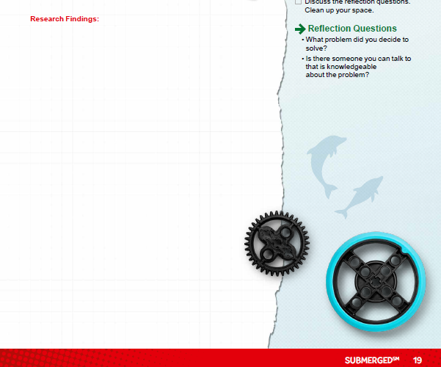
Investigations
Research the problem you have chosen.
Use this page to capture your research.
Notes:
Team Tasks (100-120 minutes)
Session Outcomes
Apply coding principles to the guided mission.
Identify their innovation project problem to solve and research solutions. (Revisit page 6 of the Engineering Notebook.)
Facilitator Tips - Team-building activities are great for teams to develop, use their Core Values, and learn how to work together.
Session 5 Tips =
The team should be able to describe how everyone contributes to the team.
If the team is sharing one robot, they can code on individual devices and then take turns running their programs on the robot.
The provided program for the guided mission will not only solve the “Send over the Submersible” mission but also be helpful to use on other missions.
Remind the team to test program changes in small steps instead of changing the entire program at once.
If an attachment is needed for a mission, keep it in a plastic bag labeled with the mission number.
Teams should be able to clearly define the problem they have chosen. This is evaluated during the judging session at the event.
The team will write their problem statement here. Remember, teams can choose one of the problems from the Project Sparks if they are unable to come up with their own idea. If they have multiple ideas, they could use a voting process to narrow it down to one.
Project resource examples include websites, videos, books, magazines, personal stories, user experiences, and experts.
The team should record what they learn and note any questions that still need to be researched to develop their solution.

Slide 9

Share
Get together at the mat.
Show how your robot scores points on the guided mission.
Discuss the problem your team has identified and think about next steps.
Discuss the reflection questions. Clean up your space.
Notes:
Share (10-15 minutes)
Team Tasks (100-120 minutes)
Session Outcomes
Apply coding principles to the guided mission.
Identify their innovation project problem to solve and research solutions. (Revisit page 6 of the Engineering Notebook.)
Facilitator Tips - Team-building activities are great for teams to develop, use their Core Values, and learn how to work together.
Session 5 Tips =
The team should be able to describe how everyone contributes to the team.
If the team is sharing one robot, they can code on individual devices and then take turns running their programs on the robot.
The provided program for the guided mission will not only solve the “Send over the Submersible” mission but also be helpful to use on other missions.
Remind the team to test program changes in small steps instead of changing the entire program at once.
If an attachment is needed for a mission, keep it in a plastic bag labeled with the mission number.
Teams should be able to clearly define the problem they have chosen. This is evaluated during the judging session at the event.
The team will write their problem statement here. Remember, teams can choose one of the problems from the Project Sparks if they are unable to come up with their own idea. If they have multiple ideas, they could use a voting process to narrow it down to one.
Project resource examples include websites, videos, books, magazines, personal stories, user experiences, and experts.
The team should record what they learn and note any questions that still need to be researched to develop their solution.

Slide 10
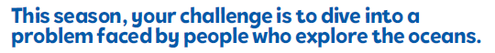
Reflection Questions
What problem did you decide to solve?
Is there someone you can talk to that is knowledgeable about the problem?
Notes:
Share (10-15 minutes)
Team Tasks (100-120 minutes)
Session Outcomes
Apply coding principles to the guided mission.
Identify their innovation project problem to solve and research solutions. (Revisit page 6 of the Engineering Notebook.)
Facilitator Tips - Team-building activities are great for teams to develop, use their Core Values, and learn how to work together.
Session 5 Tips =
The team should be able to describe how everyone contributes to the team.
If the team is sharing one robot, they can code on individual devices and then take turns running their programs on the robot.
The provided program for the guided mission will not only solve the “Send over the Submersible” mission but also be helpful to use on other missions.
Remind the team to test program changes in small steps instead of changing the entire program at once.
If an attachment is needed for a mission, keep it in a plastic bag labeled with the mission number.
Teams should be able to clearly define the problem they have chosen. This is evaluated during the judging session at the event.
The team will write their problem statement here. Remember, teams can choose one of the problems from the Project Sparks if they are unable to come up with their own idea. If they have multiple ideas, they could use a voting process to narrow it down to one.
Project resource examples include websites, videos, books, magazines, personal stories, user experiences, and experts.
The team should record what they learn and note any questions that still need to be researched to develop their solution.

Slide 11

Multimedia Resources
You may wish to embed a relevant, age-appropriate video for your students here.
Notes:
Choose a relevant, age-appropriate video for your students.

Slide 12
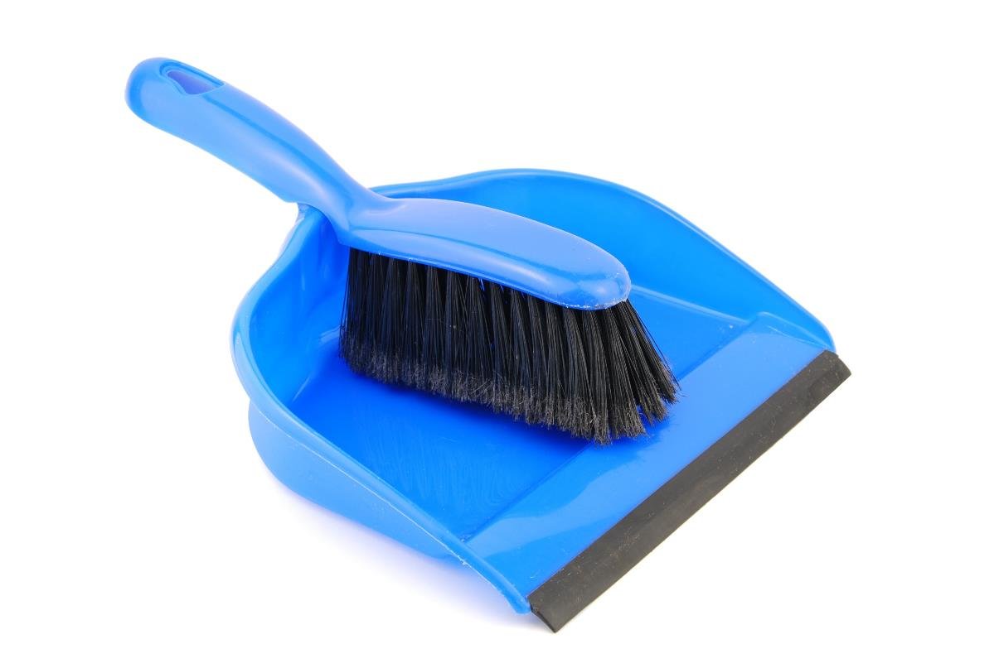
Clean Up
Notes:
Allow time for cleanup and place any unfinished models and their pieces in a sealed plastic bag.
Clean Up Pointers
You may wish to play a video or song during clean up time Link on
GoNoodle: https://family.gonoodle.com/activities/clean-up
Link on YouTube Kids: https://www.youtubekids.com/watch?v=ZJFk87ZsHn0
Link on Youtube: https://youtu.be/ZJFk87ZsHn0

Slide 13


LEGO, the LEGO logo, the SPIKE logo, MINDSTORMS and the MINDSTORMS logo are trademarks of the/sont des marques de commerce du/son marcas registradas de LEGO Group. ©2024 The LEGO Group. All rights reserved/Tous droits réservés/Todos los derechos reservados. FIRST ®, the FIRST ® logo, Coopertition ®, Gracious Professionalism®, and FIRST® DIVESM are trademarks of For Inspiration and Recognition of Science and Technology (FIRST). LEGO® is a registered trademark of the LEGO Group. FIRST® LEGO® League and SUBMERGEDSM are jointly held trademarks of FIRST and the LEGO Group. All other trademarks are the property of their respective owners. ©2024 FIRST and the LEGO Group. All rights reserved.

